Slide 1
Citibike Dataset Analysis
Aleksandar Cvetković

Slide 2
Intro notes
First thing, I want to point out that I am well aware that this way of presenting the results might be considered naïve (and even unacceptable) by the Data Science professionals. Please bear in mind that up so far I have been mainly focused on the scientific research in mathematics and academia-related work, where things are done differently.
I believe that much better way to present the obtained results is to connect Google BigQuery with Python, and compile results into one big Jupyter notebook report. Given the opportunity, I would certainly learn to do that from more experienced colleagues (or on my own, eventually) in a matter of days. But now I wanted to focus and use my time on the analysis and results, and not on the form of presentation.

Slide 3
Intro notes
To answer the questions from the Task 1, I coded and executed SQL queries in Google Big Query and analysed the results. I tried to take each question a bit further and give some additional insights. By doing so, I was simultaneously solving Task 1 and tackling the Task 2 a bit. The insights I obtained this way shaped the way I performed the analysis in the Task 2.
The charts presented in the first section were done in Tableau. The results presented in the second section were obtained by using Google BigQuery alongside with BigQuery Geo Viz.

Slide 4
Task 1
Using SQL to answer some basic questions about the New York Citibike dataset

Slide 5
Question 1: What is the unique number of stations in the dataset?
SQL query:
SELECT count(*) as station_count
FROM `bigquery-public-data.new_york_citibike.citibike_stations`
Result and analysis:
The query returns the result of 935. So, this is the number of unique Citibike stations. Inspecting the ‘citibike_stations’ table more closely (i.e. ‘is_installed’ and ‘last_reported’ columns), we see that the data is most recent, and so all of the 935 stations are currently installed and active.

Slide 6
Question 2: How many Citibikes are in the dataset?
SQL query:
SELECT COUNT(DISTINCT bikeid) as bikes_count
FROM `bigquery-public-data.new_york_citibike.citibike_trips`
Result and analysis:
The query returns the result of 17 682, which is the number of bikes that appear in the dataset. As we will note later in our analysis, not all of these bikes are currently in use. We will revisit this question later, to see how many bikes are being used actively.

Slide 7
Question 3: What is the most popular start station and end station?
SQL query (for starting stations):
SELECT
start_station_name,
COUNT(start_station_id) AS num_trips_started
FROM `bigquery-public-data.new_york_citibike.citibike_trips`
GROUP BY start_station_name
ORDER BY num_trips_started DESC
LIMIT 10

Slide 8
SQL query (for end stations):
SELECT
end_station_name,
COUNT(end_station_id) AS num_trips_ended
FROM `bigquery-public-data.new_york_citibike.citibike_trips`
GROUP BY end_station_name
ORDER BY num_trips_ended DESC
LIMIT 10

Slide 9
Results and analysis:
Top 10 most popular starting stations
Top 10 most popular end stations
Here we list the most popular start/end stations, along with the number of times a station was used as starting/ending point of a journey. Pershing Square North and E 17 St/Broadway are the most popular stations.

Slide 10
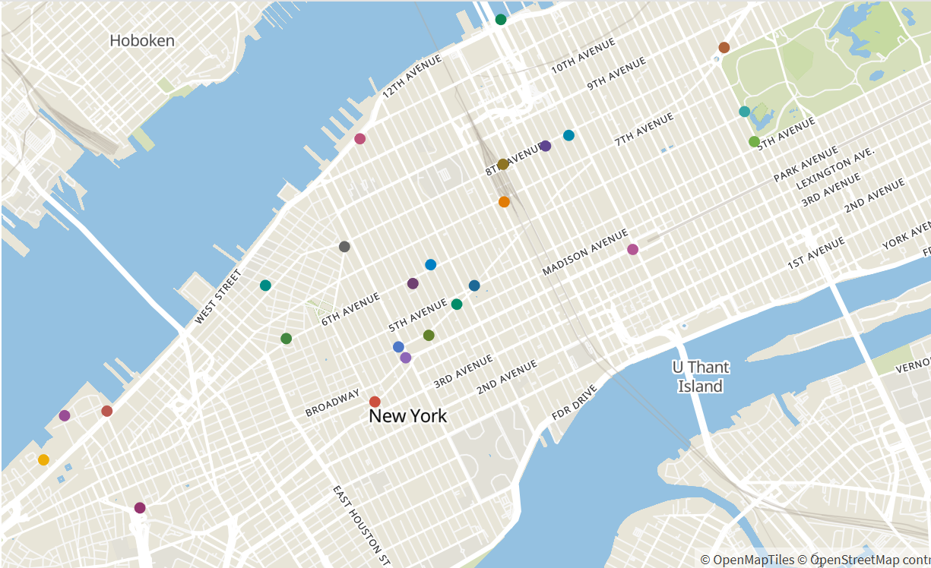
Top 25 most popular starting stations
The map of the most popular starting stations (which is almost completely identical to the corresponding end stations map) can give us a clue about most popular NYC areas: they’re settled around 3rd, 5th, 6th and 8th avenues.

Slide 11
Question 4: What is the gender distribution of the Citibike users?
SQL query:
SELECT
gender,
COUNT(gender) AS num_of_users
FROM `bigquery-public-data.new_york_citibike.citibike_trips`
WHERE bikeid IS NOT NULL
GROUP BY gender

Slide 12
Results and analysis:
From the table we see that male users are predominant: men are using Citibike three times more than women. Can the same thing be said about the cycling habits for people of New York in general? Does this three-to-one ratio apply also for people having their own bike?
User distribution across gender
It’s interesting to see how users are distributed across both gender and age. We’ll explore this in the next slide.

Slide 13
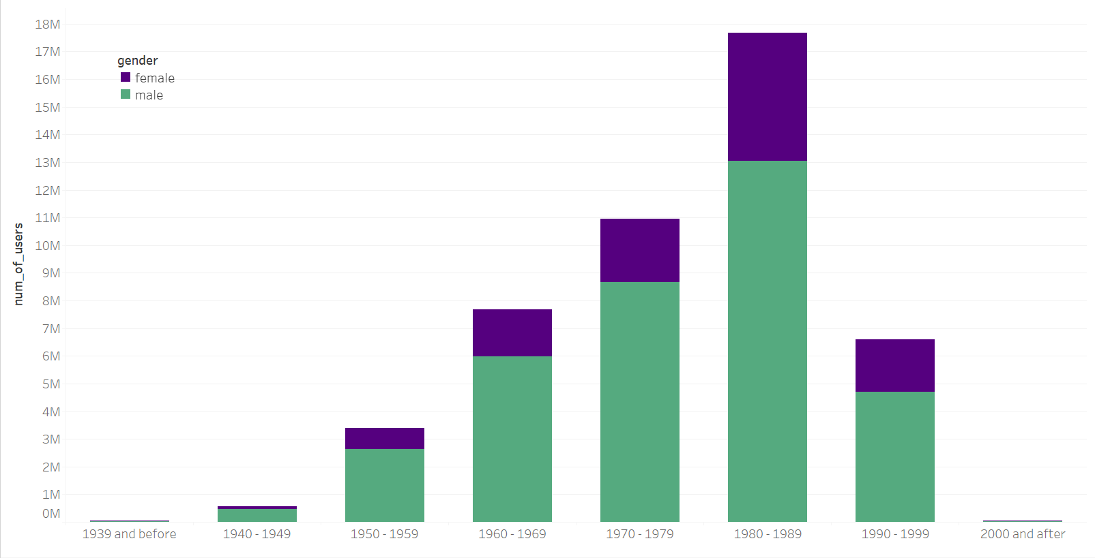
Citibike users distributed across year of birth and gender
The largest body of Citbike users come from people born during the ’80s. Again, can the same thing be said about NYC bike users in general? In addition, we see that the 1:3 (or even 1:4) distribution of male-to-female users is consistent through all the generations.

Slide 14
Question 5: What is the usertype distribution of the Citibike users?
SQL query:
SELECT
usertype,
COUNT(usertype) AS num_of_users
FROM `bigquery-public-data.new_york_citibike.citibike_trips`
WHERE bikeid IS NOT NULL
GROUP BY usertype

Slide 15
Results and analysis:
There are significantly more subscribers to Citibike service than the ‘pay-per-ride’ users. We might assume that most of the subscribers are actually NYC residents, while tourists will usually fall into the other category. This can also explain the huge difference in numbers: New York locals who subscribe use the service more often, since they don’t need to pay for every single ride. For many of them, Citibike is a part of their daily life, and they use it to commute around less popular areas, unlike tourists.
User distribution across type of users

Slide 16
Question 6: What is the trip duration distribution of the Citibike trips?
SQL query:
SELECT
CASE
WHEN tripduration > 0 AND tripduration <= 300 THEN 'very short trip’
WHEN tripduration > 300 AND tripduration <= 900 THEN 'short trip’
WHEN tripduration > 900 AND tripduration <= 2700 THEN 'medium trip’
WHEN tripduration > 2700 AND tripduration <= 5400 THEN 'long trip’
WHEN tripduration > 5400 AND tripduration <= 10800 THEN 'very long trip’
WHEN tripduration > 10800 AND tripduration <= 86400 THEN 'day tour’
WHEN tripduration > 86400 THEN 'outlier’
END AS trip_dur,
COUNT(bikeid) AS num_of_trips
FROM `bigquery-public-data.new_york_citibike.citibike_trips`
WHERE tripduration IS NOT NULL AND bikeid IS NOT NULL
GROUP BY trip_dur

Slide 17
Results and analysis:
Trip duration distribution
Medium and short trips are by far the most popular ones. Quite short trips are not taken as much, but still much more frequently than trips that last an hour or more.
It will be interesting to see how trips are distributed across both duration and user type. We’ll explore this in the next slide.

Slide 18
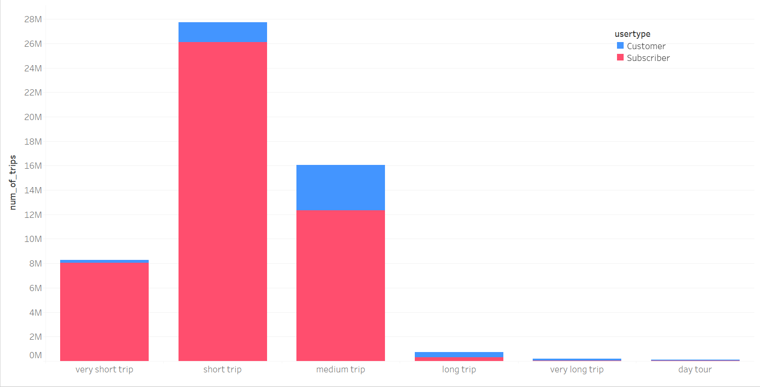
Citibike trips distributed across trip duration and user type
Very short trips are almost always undertaken by subscribers. The situation is also similar with the short trips. If we assume that subscribers are NYC locals, this makes more sense: Citibike is a part of their daily routine, and they use it to move around the neighbourhood. The difference between subscribers and customers is smaller for medium trips, but subscribers are still predominant, as they might be using Citibike to commute from home to work, for example.

Slide 19
Citibike trips distributed across trip duration and user type
But the story is completely different for longer trips! In this case ‘pay-per-ride’ customers overtake subscribers. If we assume that many customers are also tourists, then this also makes sense: they will want to rent a bike for a bike-tour around the city, probably commuting around the most popular areas.

Slide 20
Question 7: What is the most popular Citibike trip?
SQL query:
SELECT
CONCAT(start_station_name,' - ',end_station_name) AS trips,
ROUND(AVG(tripduration)/60, 2) AS avg_trip_time,
COUNT(bikeid) AS num_of_trips
FROM `bigquery-public-data.new_york_citibike.citibike_trips`
WHERE bikeid IS NOT NULL
GROUP BY trips
ORDER BY num_of_trips DESC
LIMIT 10

Slide 21
Results and analysis:
Top 10 most popular trips
Let’s observe top two routes: they are considerably more popular than other routes, they have the same starting and end station, they are both medium/long trips, and they both refer to Central Park South. All this can reveal a favourite habit of Citibike users: taking a nice long tour through the Central Park.
This can also explain why there’s almost an equal number of subscribers (locals) and costumers (tourists) taking longer rides: whether you are a local or not, you’d want to cycle around Central Park.

Slide 22
Top 10 most popular trips
The third entry is also interesting to note: 30 minute trips starting and ending at the same station, located in southern New York. We can assume that biking around south NY (and enjoying all the sights there) is also quite popular.

Slide 23
Top 10 most popular trips
Observing this table we can see that there is another way to interpret the customer data: it can represent not only NYC visitors, but locals who don’t own a bike, but rent a Citibike for occasional recreation.

Slide 24
Top 10 most popular trips
Another thing to note is that most of the listed routs are loops, having the same start and end stations. Let’s explore what’s the situation with routes having different start/end stations.

Slide 25
SQL query (for non-loop trips):
SELECT
CONCAT(start_station_name,' - ',end_station_name) AS trips,
ROUND(AVG(tripduration)/60, 2) AS avg_trip_time,
COUNT(bikeid) AS num_of_trips
FROM `bigquery-public-data.new_york_citibike.citibike_trips`
WHERE start_station_name != end_station_name
AND bikeid IS NOT NULL
GROUP BY trips
ORDER BY num_of_trips DESC
LIMIT 10

Slide 26
Top 10 most popular non-loop trips
The situation is not much different for non-loop trips: West Side and Central Park are predominant. The noticeable difference is that shorter trips are more often in this case.

Slide 27
What about the Pershing Square North? We saw that it’s the most popular starting station, but it didn’t appear anywhere on our top routes results. Let’s dig in by listing the most popular routes having Pershing Square North as a start station.
Top 10 most popular trips starting from PSN
All of the listed trips are short and thus probably mostly used by locals. While tourists tend to stick to popular routes, locals tend to take more diverse routes, according to their daily needs. And it seems that the daily life of locals is more centered on the East Side.

Slide 28
Question 8: Was there new bike introduced or removed at any point in time? What makes you think it did or didn’t? What about the citibike stations?
SQL query (for added bikes):
SELECT
bikeid,
EXTRACT(YEAR FROM MIN(starttime)) AS year_first_used,
FROM `bigquery-public-data.new_york_citibike.citibike_trips`
WHERE bikeid IS NOT NULL
GROUP BY bikeid
ORDER BY year_first_used DESC
LIMIT 2

Slide 29
SQL query (for removed bikes):
SELECT
bikeid,
EXTRACT(YEAR FROM MAX(starttime)) AS year_last_used,
COUNT(bikeid) as times_used
FROM `bigquery-public-data.new_york_citibike.citibike_trips`
WHERE bikeid IS NOT NULL
GROUP BY bikeid
ORDER BY year_last_used
LIMIT 2

Slide 30
Results and analysis:
Some recently introduced bikes
Citibike started its operation in 2013, and from the queried table we see that some new bikes are introduced in 2018.
Bikes not in use anymore
Table above shows that there are also bikes removed since 2013, and used just few hundred times.

Slide 31
Since some of the bikes are not in use anymore, it is interesting to revisit Question 2 from this point, and see how many bikes were being used in 2018 (since this is the last time the database in BigQuerry was updated).
SQL query:
SELECT COUNT(DISTINCT bikeid) as bikes_count
FROM `bigquery-public-data.new_york_citibike.citibike_trips`
WHERE EXTRACT(YEAR FROM starttime) = 2018
The query returns bike count of 12 947.
(And the same query for year 2013 returns a count of 6 503)

Slide 32
SQL query (for added stations):
SELECT
start_station_name,
EXTRACT(YEAR FROM MIN(starttime)) AS year_first_used
FROM `bigquery-public-data.new_york_citibike.citibike_trips`
WHERE start_station_name != ‘’
GROUP BY start_station_name
ORDER BY year_first_used DESC
LIMIT 10

Slide 33
SQL query (for removed stations):
SELECT
start_station_name,
EXTRACT(YEAR FROM MAX(starttime)) AS year_last_used,
COUNT(*) AS times_used,
FROM `bigquery-public-data.new_york_citibike.citibike_trips`
WHERE start_station_name != ‘’
GROUP BY start_station_name
ORDER BY year_last_used, times_used
LIMIT 10

Slide 34
Some recently introduced stations
Stations not in use anymore
Following the same reasoning as with the added/removed bikes, we can conclude that there were changes in stations infrastructures, some of the being added, while others were removed.

Slide 35
It might be interesting to think about why the stations listed above were used so little and then ultimately removed. Closer inspection reveals that all three stations are located near East River, first two in Brooklyn the third one in Manhattan. They are also not to far from each other. Maybe biking along East River is not that popular? Maybe people from New York don’t like to use bikes to cross the bridges between Brooklyn and Manhattan?

Slide 36
Task 2
Popular areas in NYC

Slide 37
We already gave some insights about popular NYC areas by going through the previous task. We saw that
There is a noticeable difference between subscriber and customer user types. We can make assumptions about the behaviour of NYC locals based on subscriber data, and assumptions about NYC visitors (and locals’ leisure habits) based on the customer data.
Making tours around Central Park and Lower Manhattan is quite popular among visitors and locals as well.
Manhattan Midtown might be the main point of interst.

Slide 38
NYC top areas
Now we will further explore which areas are most popular in New York, given certain conditions. First, we will see which areas are most popular among subscribers and customers in general, and then we’ll play a variation on a theme, by changing settings.

Slide 39
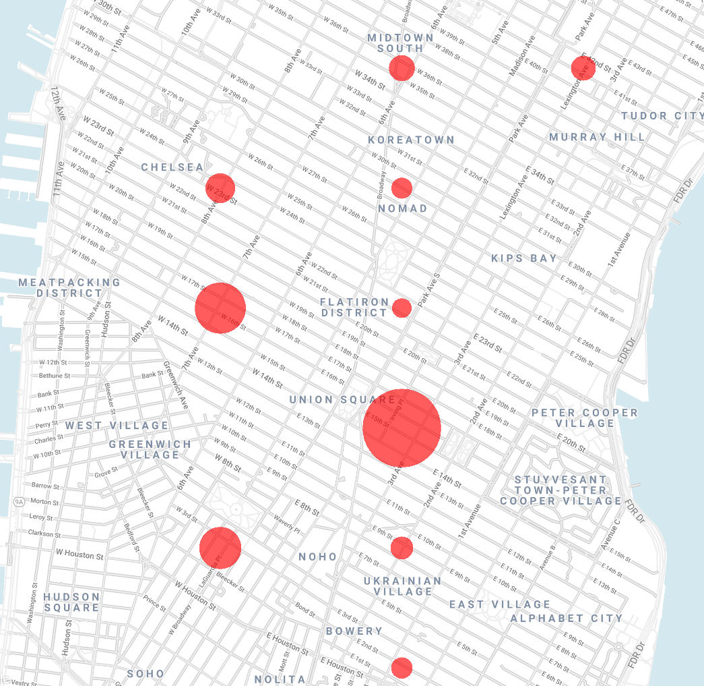
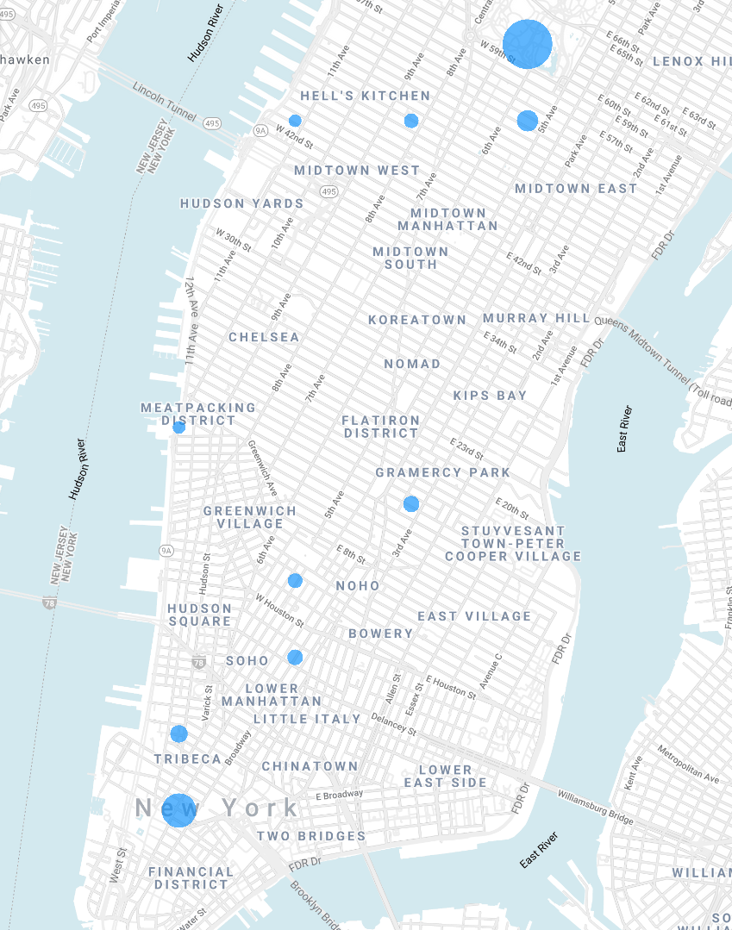
Most popular NY areas,
based on end stations and subscriber data
Most popular NY areas,
based on end stations and customer data

Slide 40
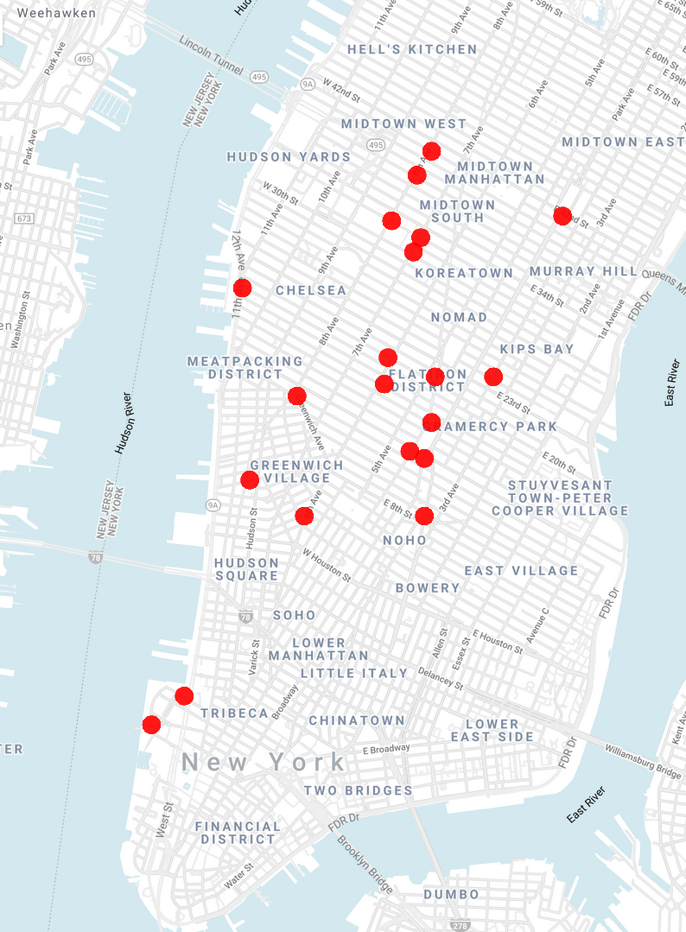
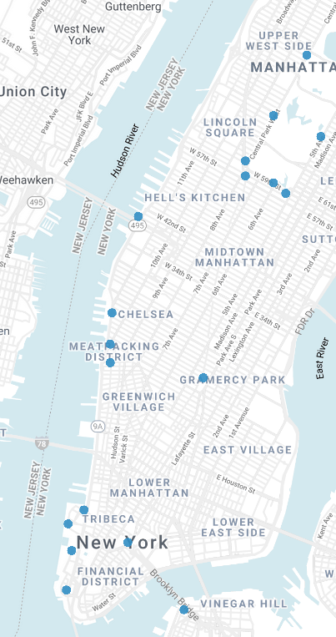
Most popular NY areas,
based on end stations and subscriber data
Most popular NY areas,
based on end stations and customer data

Slide 41
Location charts on the previous slide were made by counting how many trips were finished in a given area. Each circle represent a center of an area. For the first slide, bigger circle means that more trips were finished there, i. e. we can assume that the area is more popular. By comparing them, we can conclude the following:
Locals tend to spend more time in Midtown and Lower East Side, with area around the Union Square being the most active.
Whole span form E Huston Street to E 42nd St, along the Broadway, is most popular among locals, with the area around Union Square being the biggest point of interest.
Visitors, and locals who want to recreate, prefer touring around Central Park, and alongside Hudson river.

Slide 42
Autumn in New York
Let’s now explore how trends change over seasons. First we’ll focus on NY locals.

Slide 43
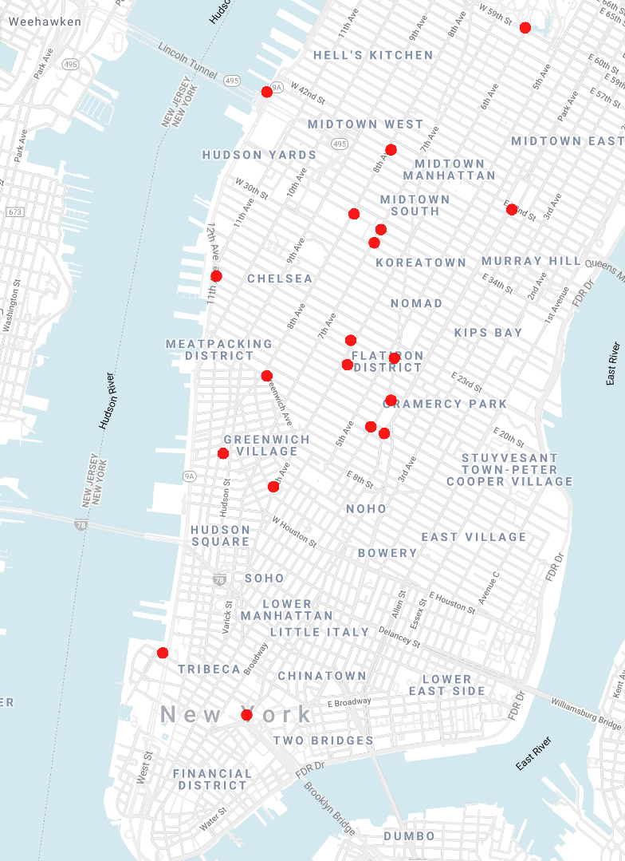

Spring
Summer

Slide 44
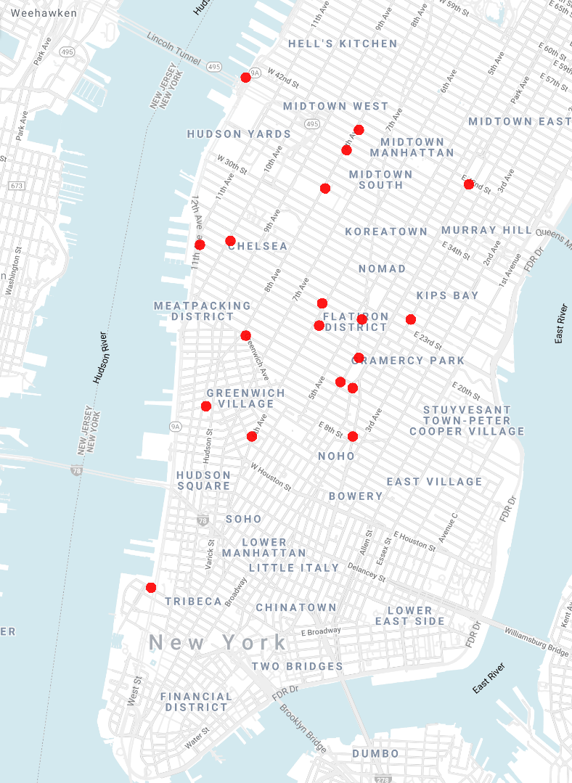
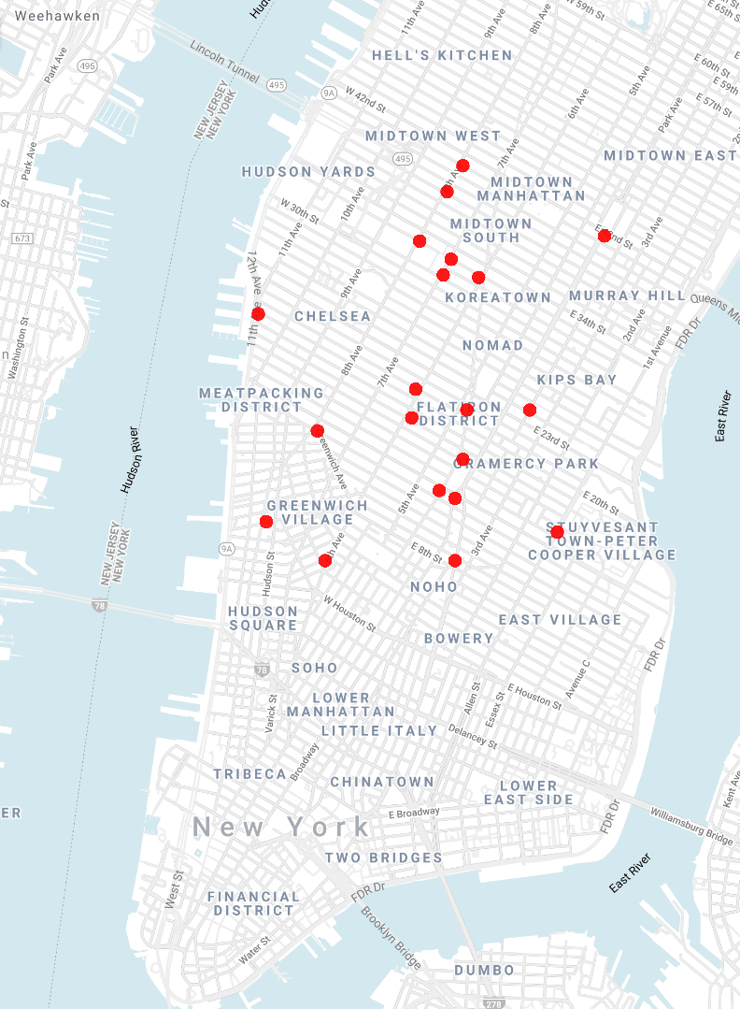
Autumn
Winter

Slide 45
As weather gets colder, we notice that New Yorkers will get away from the river coast and converge to the Midtown.
Let’s now explore customer data.

Slide 46
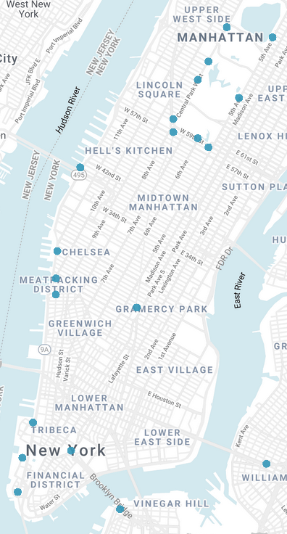
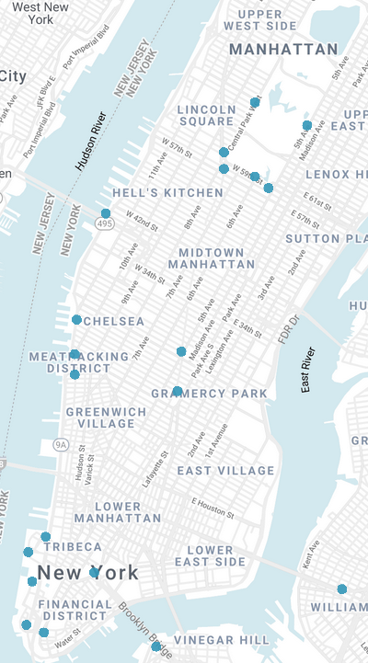
Spring
Summer

Slide 47
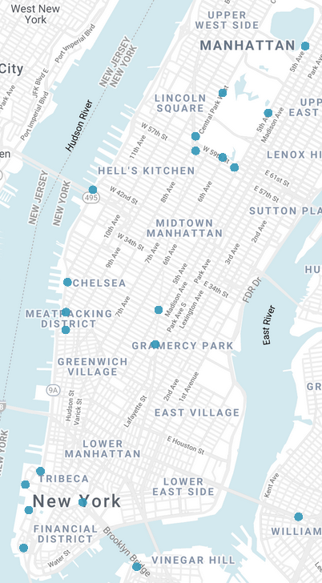
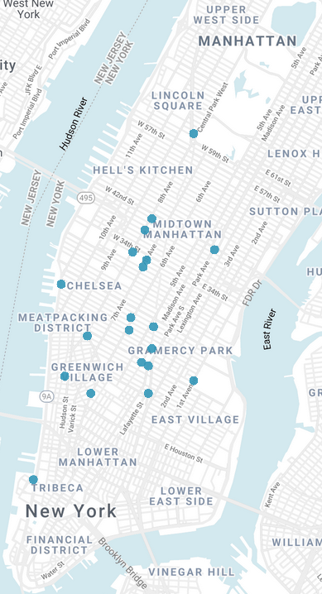
Autumn
Winter

Slide 48
The similar trend applies to customers: they will prefer to group around the Midtown as temperatures start falling.
During the warmer days people like to relax along the Hudson river and Central Park. Interestingly, Central Park is popular in autumn as it is in spring.

Slide 49
Celebration time
It’s fun to see which areas are most lively during the biggest American holidays: Christmas and Independence Day.

Slide 50
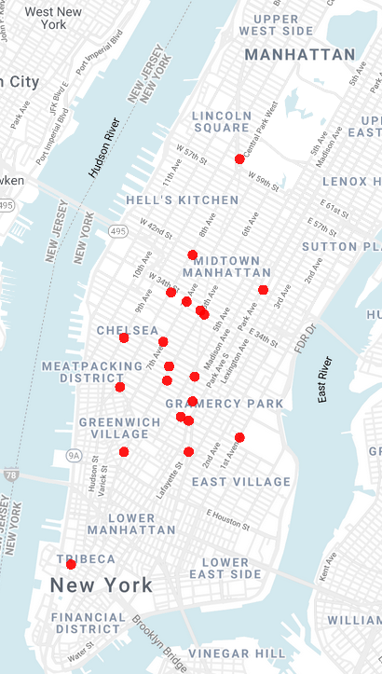
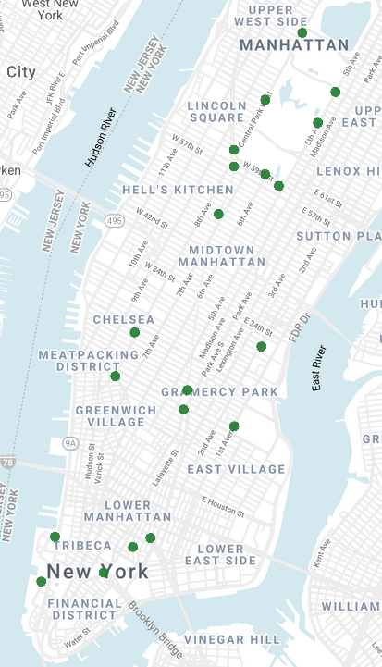
The day before Christmas
Xmas time!

Slide 51
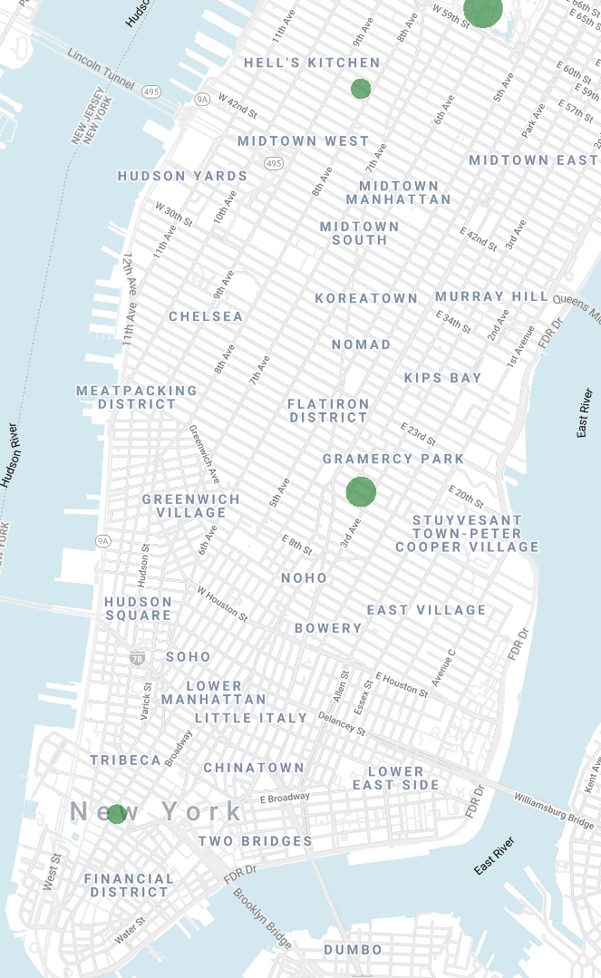
Even though it’s winter, everyone gets away from the Midtown to enjoy Christmas in Central Park and goes even close to the river! Let’s see the greater top four most frequented areas on Christmas:
Three of the results are pretty clear from the previous picture: Central Park, the ever-active Union Square and southern part of the island. But what about the fourth point, the one near Hell’s Kitchen? Let’s zoom on it.

Slide 52
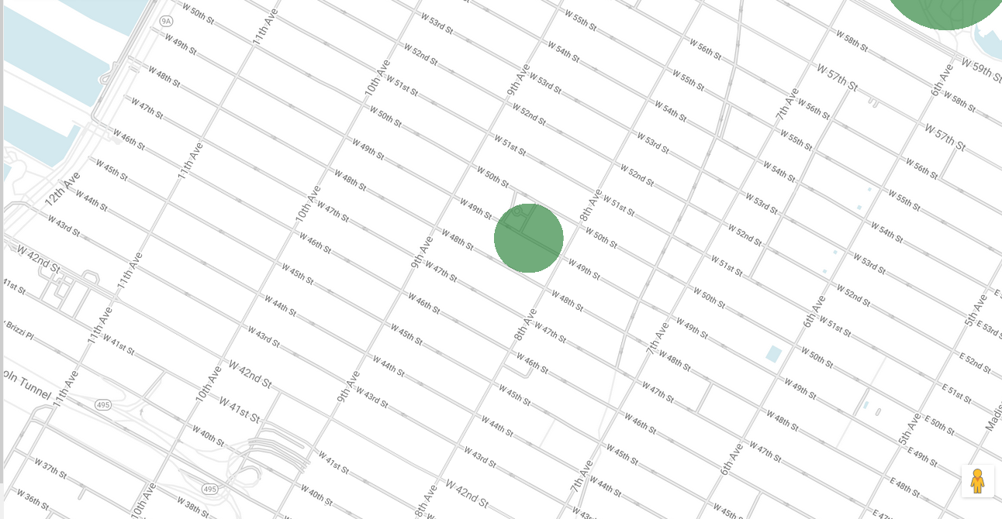
It centers on the W 49th Street, exactly the street of the Rockefeller Center where each Christmas a giant Christmas tree is displayed, which everyone comes to see.

Slide 53
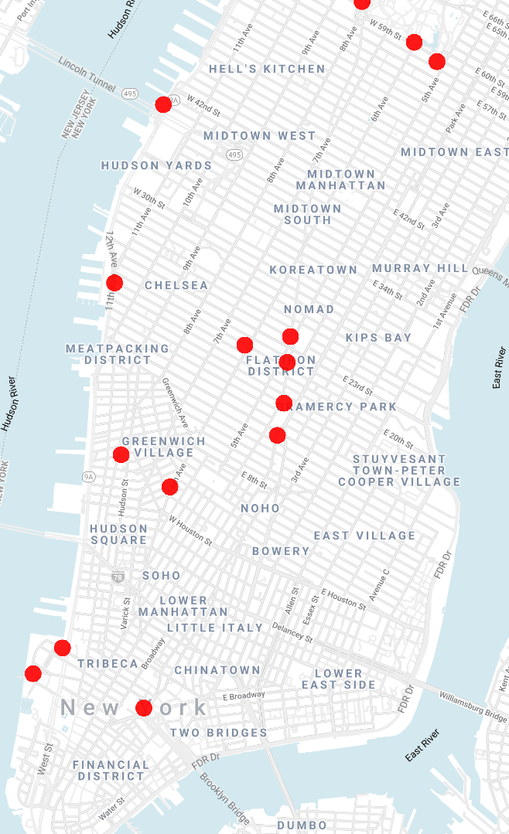
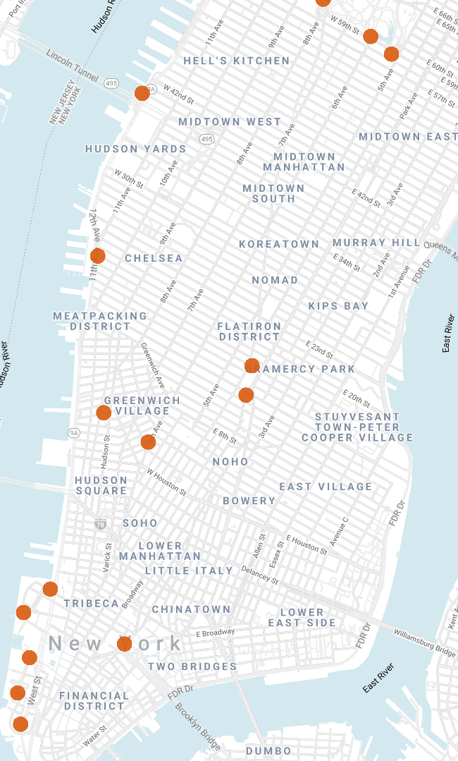
3rd July
4th July
Everyone gets away from Midtown to enjoy fireworks along the coast during the 4th July!

Slide 54
NY ‘round the clock
Let’s now examine city’s daily rhythm.

Slide 55
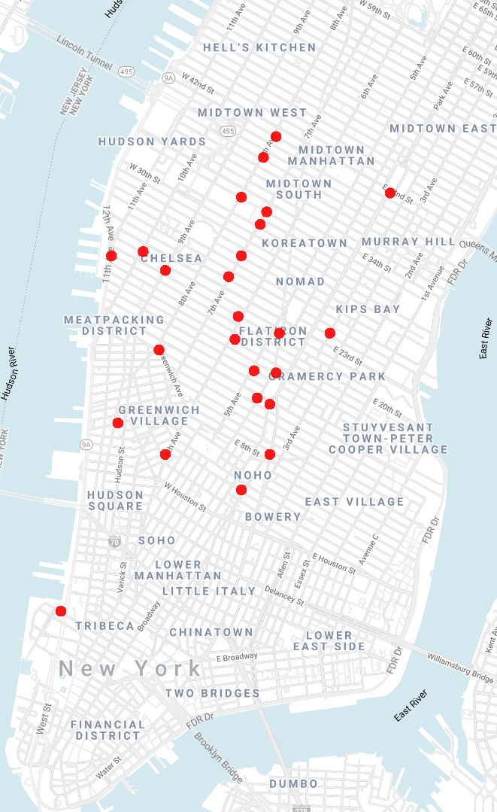
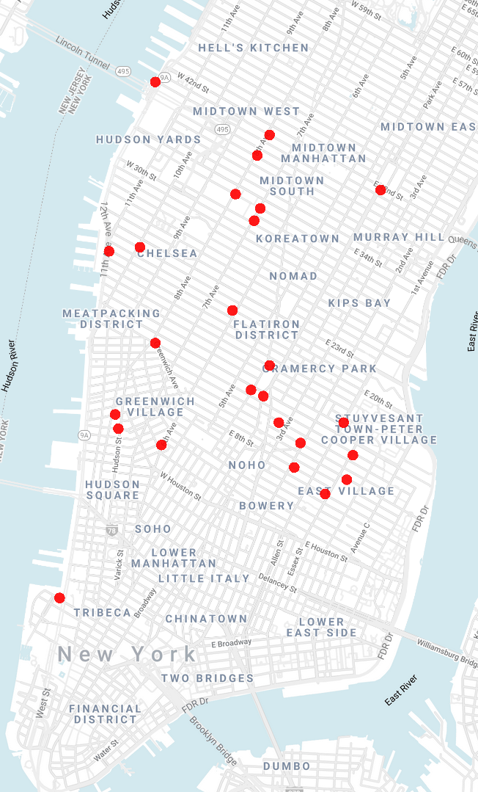
Work hours
(9 – 17h)
After work hours
(17 – 21h)

Slide 56
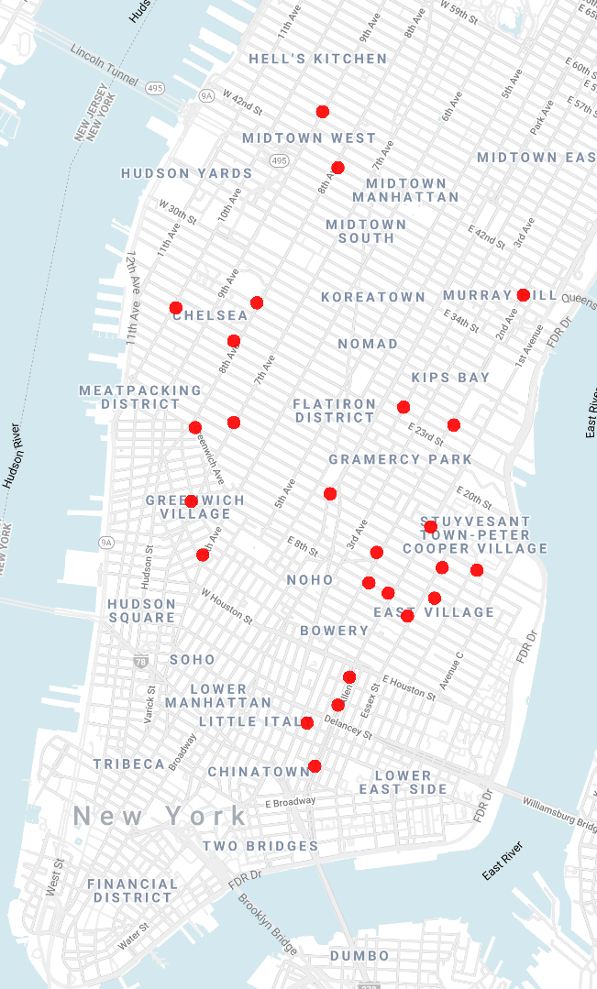
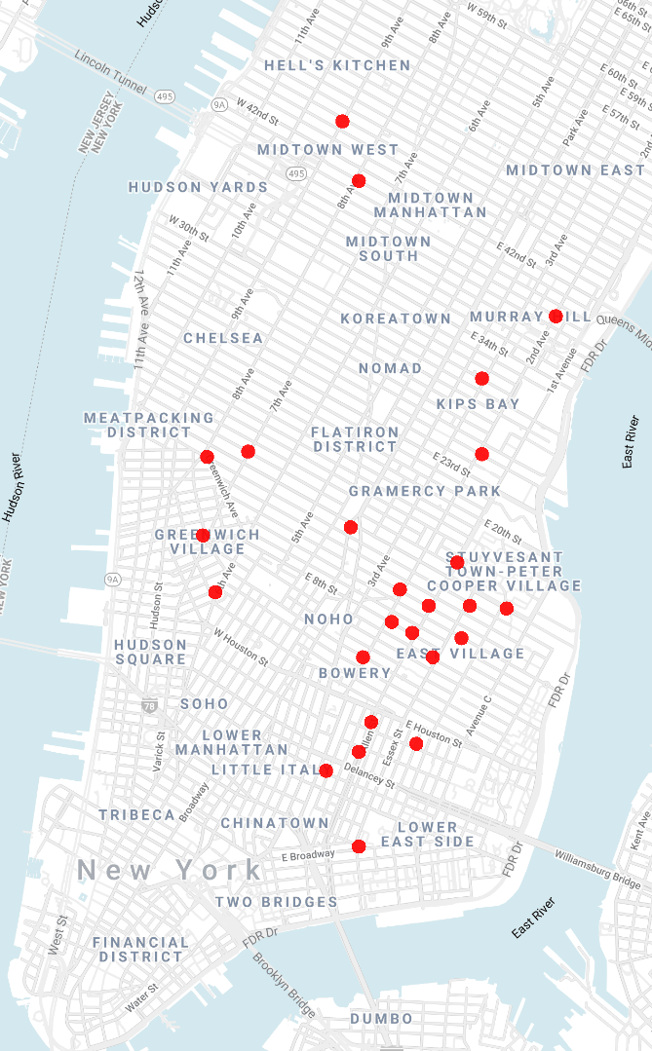
Before midnight
(21 – 23h)
After midnight
(00 – 04h)

Slide 57
One trend is clearly apparent: as the day goes by, people are converging from the West Side to the East Side. We cam make an assumption that many people in New York live on the East Side and travel to the West Side for work and other daily activities.
Another assumption we can make is that East Side (around the Union Square) is bursting with social activities and rich nightlife.

Slide 58
NYC ≠ Manhattan
What about the other parts of New York? We focused only on Manhattan, since it’s the by far the most active core of the city. But why don’t we use this data to say something about residents of other parts?
We can observe Brooklyn, for example. Let’s track the routes starting from Brooklyn Heights to see where people staying there like to commute.

Slide 59
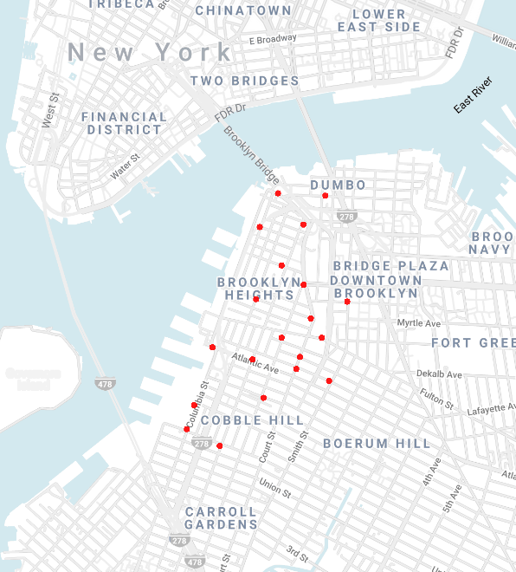
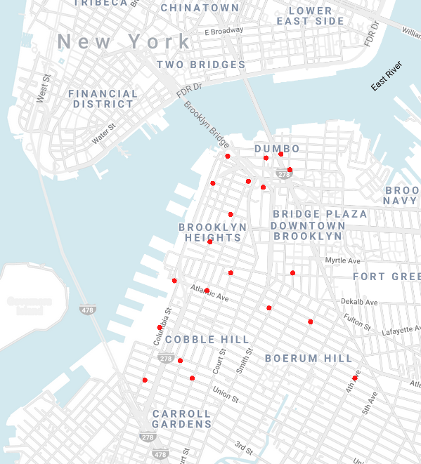
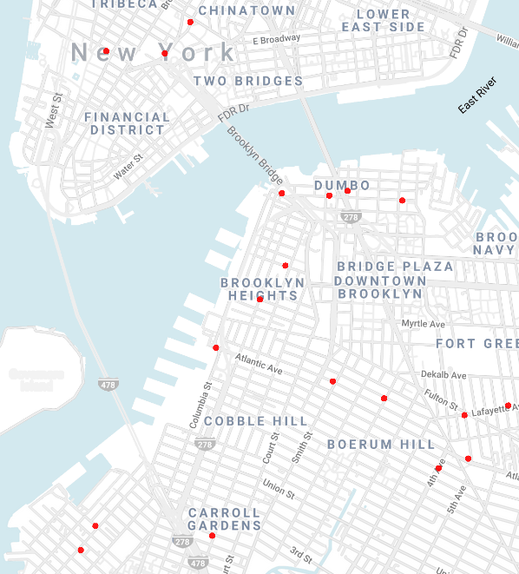
5 minute rides from Brooklyn Heights
10 minute rides from Brooklyn Heights
> 15 min. rides from Brooklyn Heights

Slide 60
People from Brooklyn Heights, usually visit Dumbo, area around Metropolitan Ave and East River coast, Chinatown and southern part of the Manhattan island.
Knowing this information can be quite useful: we can consider those areas as ‘extensions of Brooklyn Heights’. Having this in mind, we can (for example) place there stores, brands and bank ATMs which are already popular among people living in Brooklyn Heights. By opening a store there, we will have some customers from Brooklyn Heights to start with, while attracting new customers from the new area.

Slide 61
Upper West Side Story
We saw that there is a substantial difference between male and female users. Let’s check if their habits also vary that much on some sample. We’ll do this by checking favourite routes for people living in Upper West Side. We focus only on Citibike subscribers and trips that took more than 15 minutes.

Slide 62
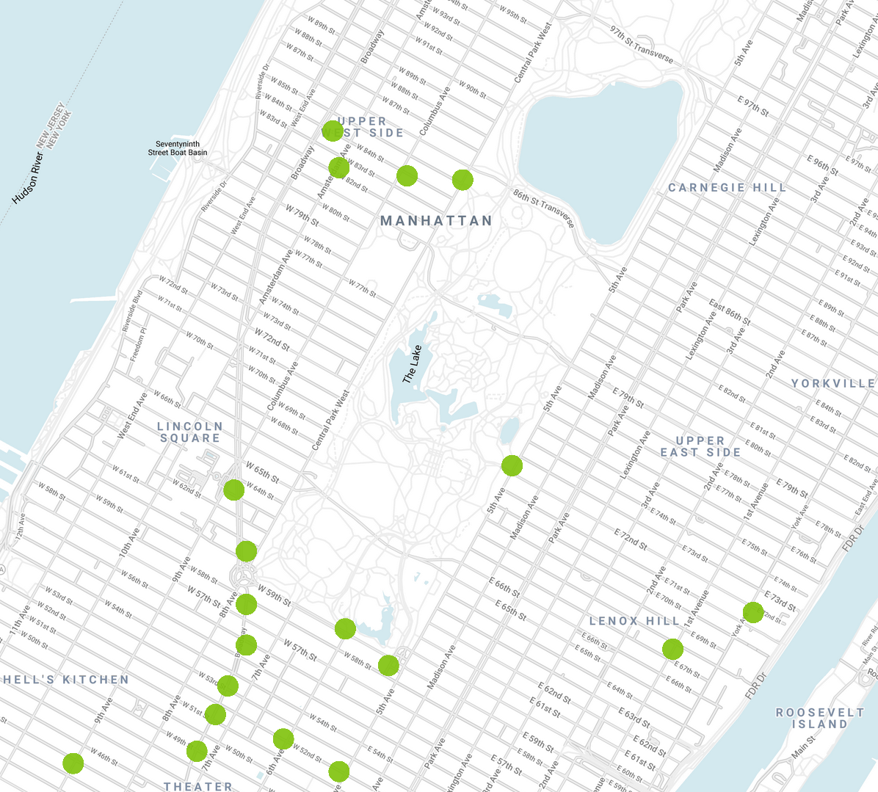
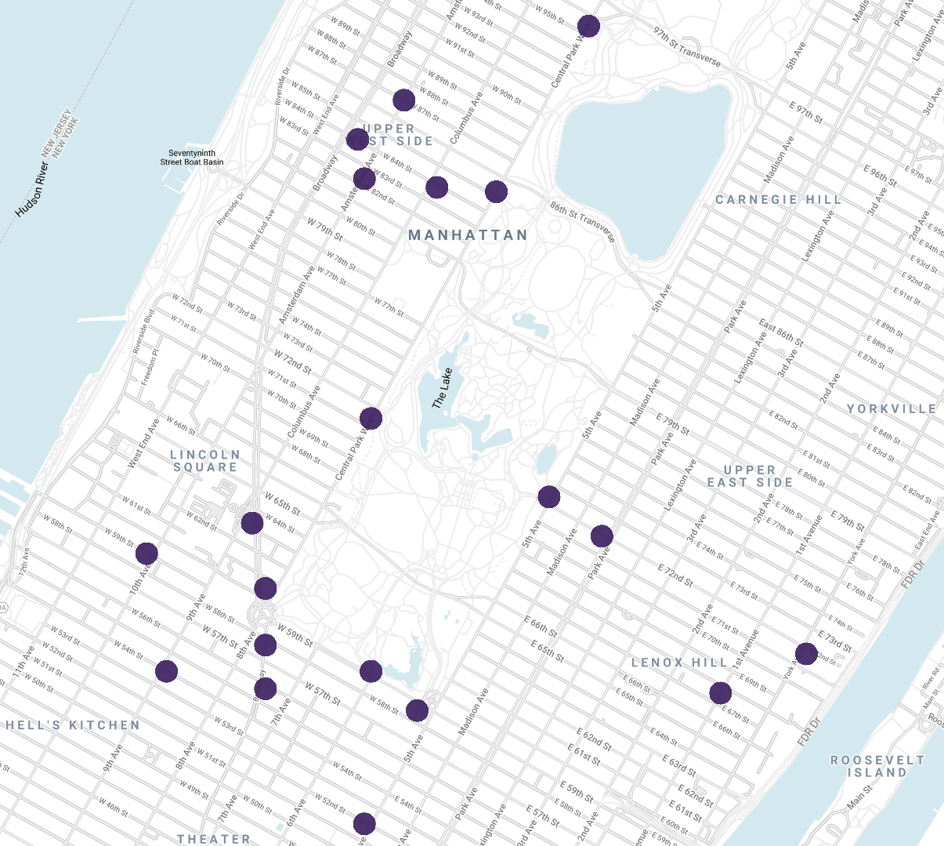
Male users
Female users

Slide 63
The picture is not significantly different, but we can notice something interesting: men tend to commute to Broadway more.
This can mean that Broadway is more popular among men living in Upper West Side than their female counterparts.
Another conclusion we can derive is that, perhaps, there are more men working in Broadway then women.

Slide 64
Getting famous
We already determined which areas are most popular. But how did their popularity changed over time? Which areas are became more famous recently? We will see how the top five areas changed from 2013 to 2015.

Slide 65
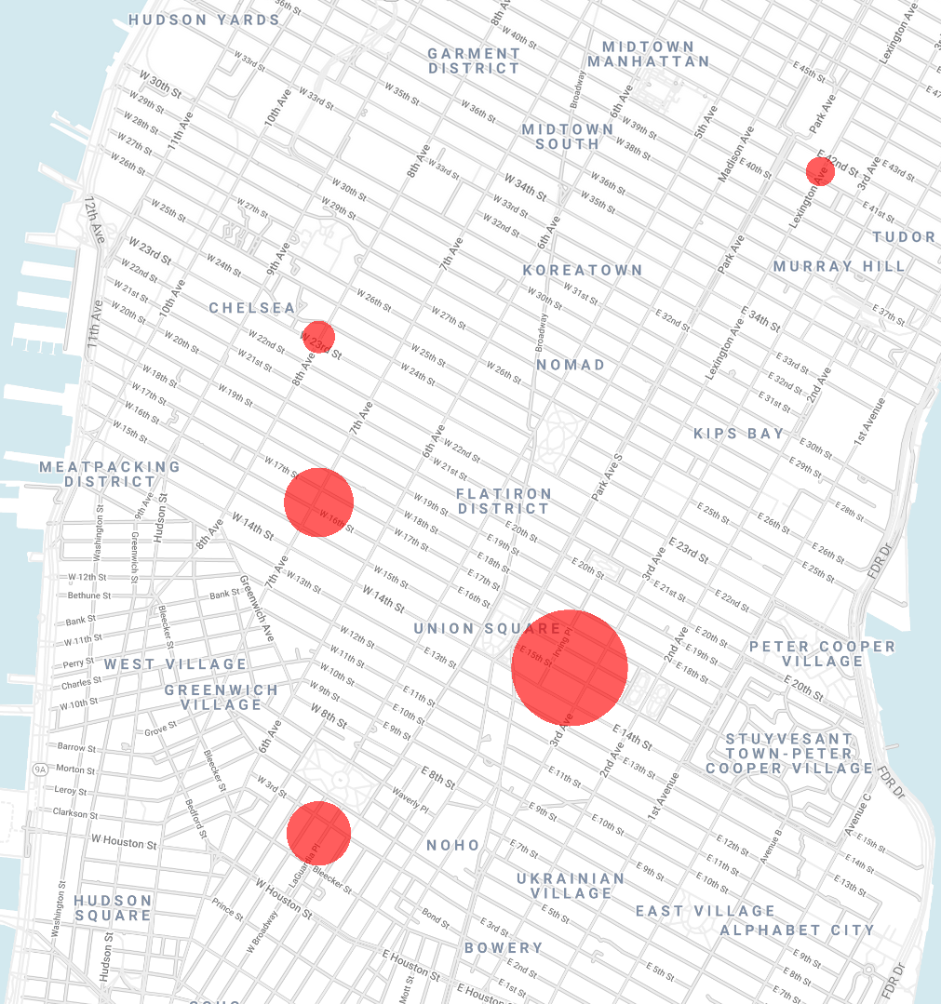
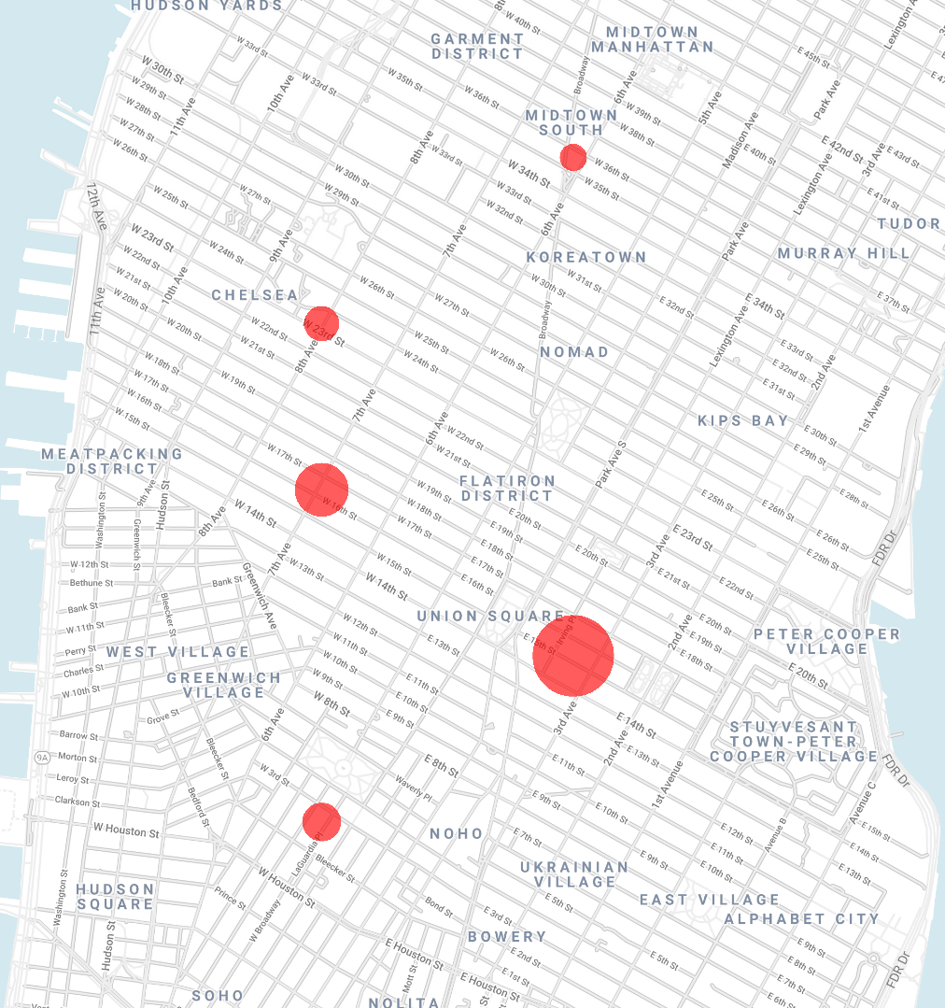
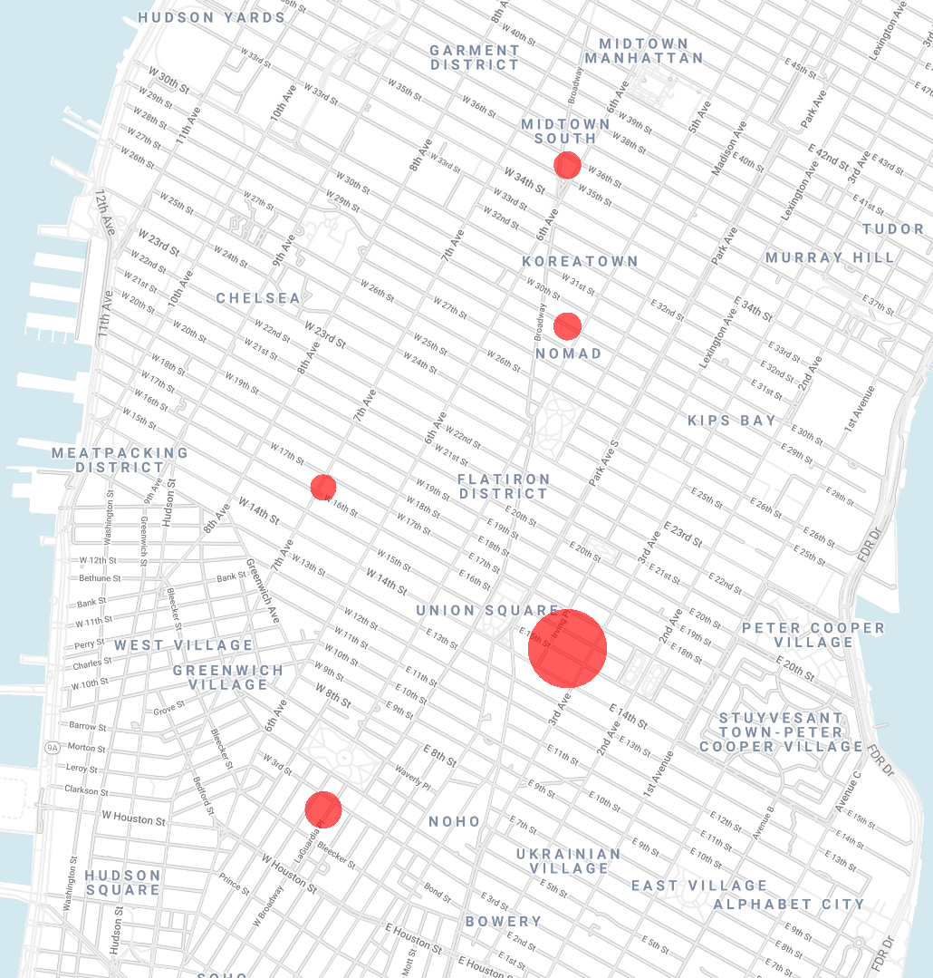
2013
2015
2018
We conclude that Midtown South and Koreatown have been becoming increasingly popular in the recent years, with the area around the Union Square keeping its status as the most active.

Slide 66
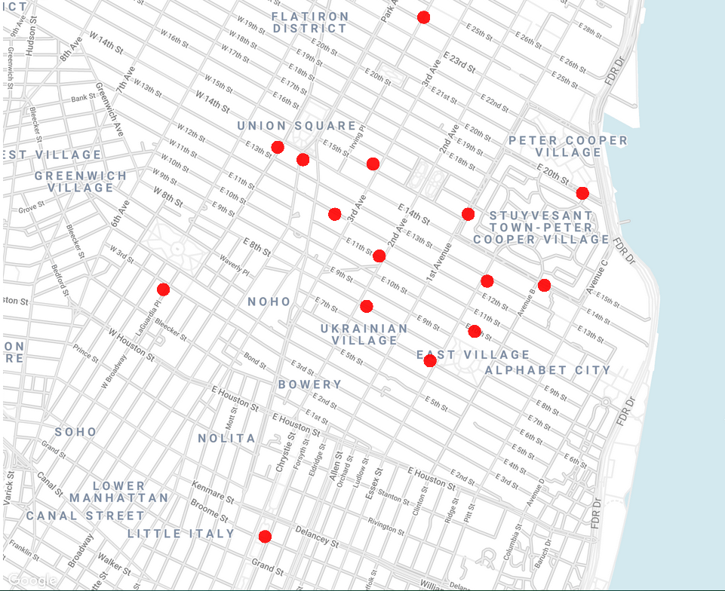
To finish the analysis off, we will check where do the young people like to go out in the evening the most.
Area between Union Square, Ukrainian, East and Cooper Village seems to be the most visited by young crowd that goes out after 8pm, until the morning hours.
Data from people born after 1994

Slide 67
Outro notes
Here I managed to outline some of the ways we can utilise the given dataset and draw insights about the dynamics of life and habits in NYC. One of the possible ways to further explore the dataset is to combine the presented approaches in different ways; we can, for example, explore where people from New Jersey like to go out, or women from Upper East Side like to recreate.
There are, of course, many other different ways how this dataset could be used, especially if we manage to come across some additional data such is subscriber’s profession, whether they use some other means of transport, and so on.

